Slide 1
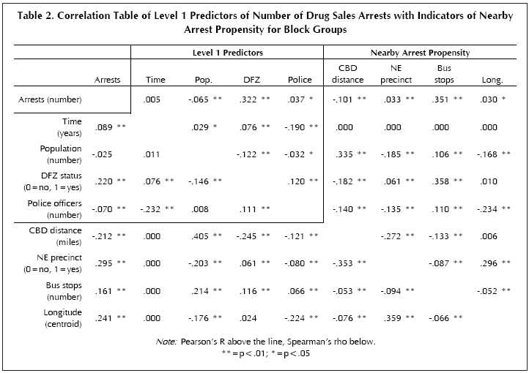
Correlation
Geog4/6300

Slide 2
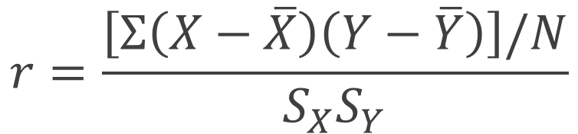
Pearson’s correlation coefficient
$$r=\frac{\left[Σ\left(X−\overline{X}\right)\left(Y−\overline{Y}\right)\right]/N}{S_{X}S_{Y}}$$
Average product of the deviations from the mean
Standard deviations standardize those deviations
r=Pearson’s correlation coefficient
X and Y are two variables
N= number of paired data values
S_{X} and S_{Y} = standard deviations of X and Y, respectively

Slide 3
Correlation
r is a useful descriptive statistic indicating the strength of relationship between two variables.
Question: Are two datasets correlated?
Null Hypothesis: No correlation between the population of two variables. X and Y are independent.
Alternative Hypothesis: directional (one-tailed) or non-directional (two-tailed).
  One tailed: You have a logical expectation of the correlation being positive or negative.
  Two-tailed: No rationale exists to expect positive or negative correlation.

Slide 4
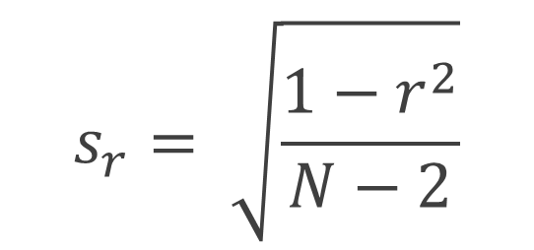
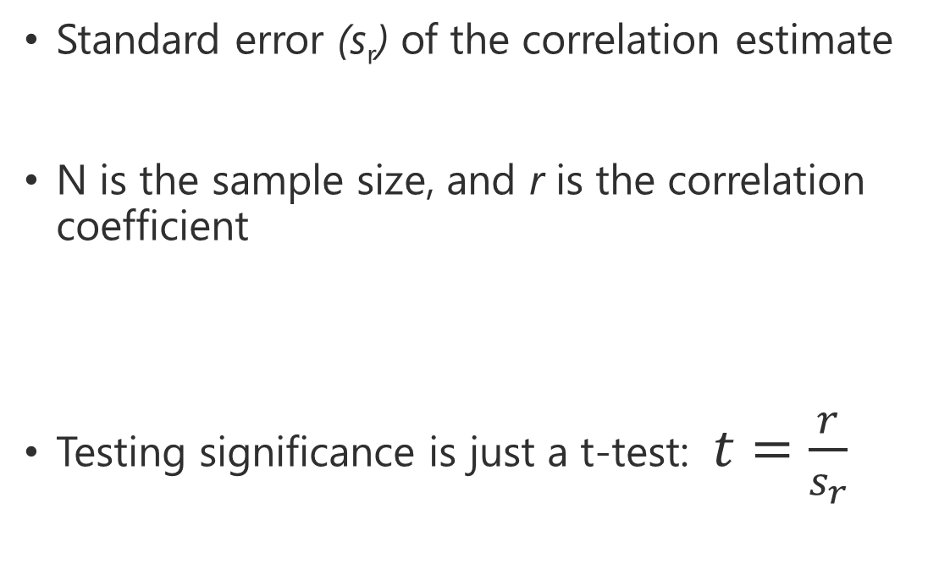
Measuring significance in correlation
Standard error (s_{r}) of the correlation estimate
N is the sample size, and r is the correlation coefficient
Testing significance is just a t-test: $t=\frac{r}{s_{r}}$
$$s_{r}= \sqrt{\frac{1−r^{2}}{N−2}}$$

Slide 5
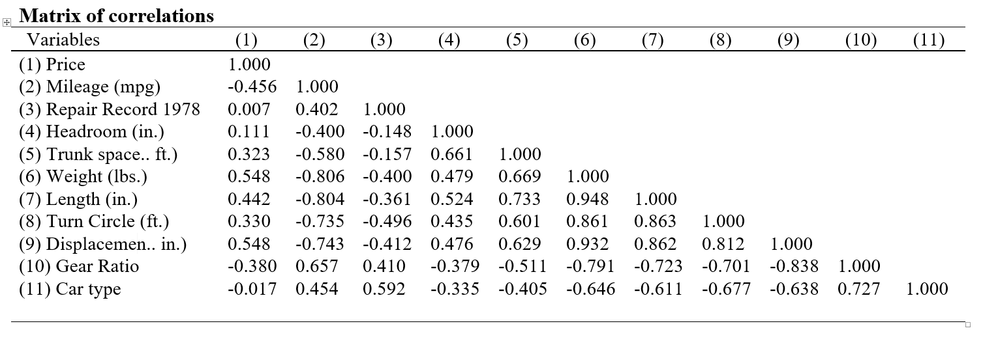
Correlation
How do variables co-vary with one another?
Range of -1 (inversely correlated) to 1 (positively correlated)
https://fintechprofessor.com/2018/03/05/export-high-quality-table-correlations-stata-ms-word/
Notes:
Alternative hypothesis is usually what you’re trying to prove.

Slide 6
Summarizing patterns
What trends do you see in this table? How would you group these variables based on direction and magnitude?
https://fintechprofessor.com/2018/03/05/export-high-quality-table-correlations-stata-ms-word/
Notes:
Alternative hypothesis is usually what you’re trying to prove.

Slide 7
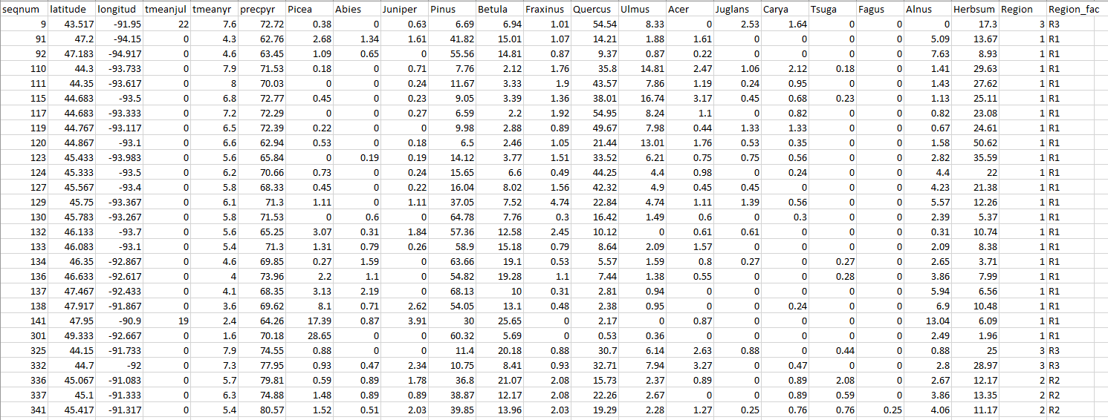
Let’s try it!
Correlation of Midwest pollen data in Excel.
How are species related to one another and lat/long?
Notes:
Alternative hypothesis is usually what you’re trying to prove.

Slide 8
Write up your results!
What variables have the strongest positive/negative correlations?
Are there exceptions that stand out?
What examples illustrate the trends you identified? Exceptions to those trends?
Notes:
Alternative hypothesis is usually what you’re trying to prove.

Slide 9
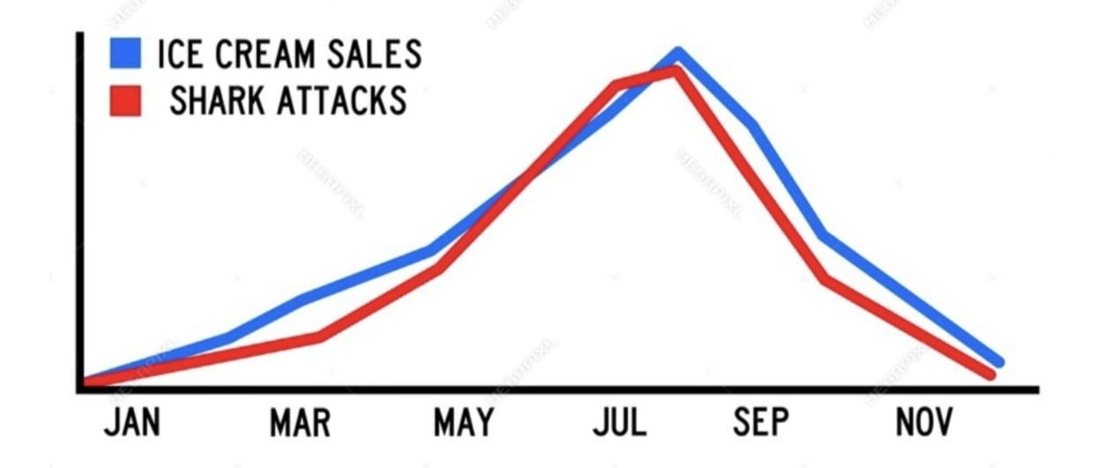
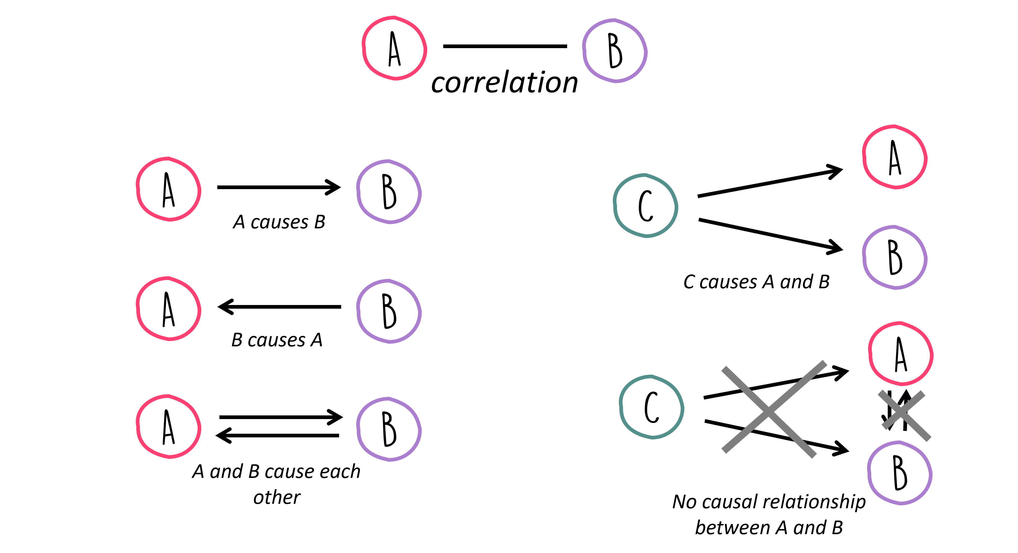
Correlation is NOT causation!
https://florian-huber.github.io/data_science_course/notebooks/11_correlation_analysis.html

Slide 10
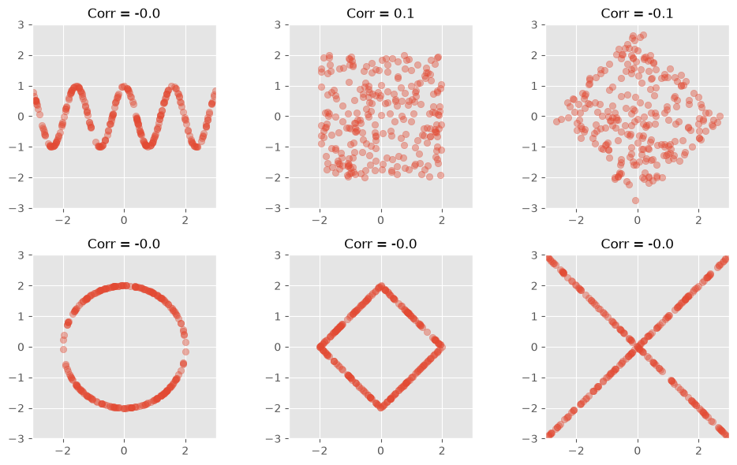
C0rrelation also has blind spots
https://florian-huber.github.io/data_science_course/notebooks/11_correlation_analysis.html

Slide 11
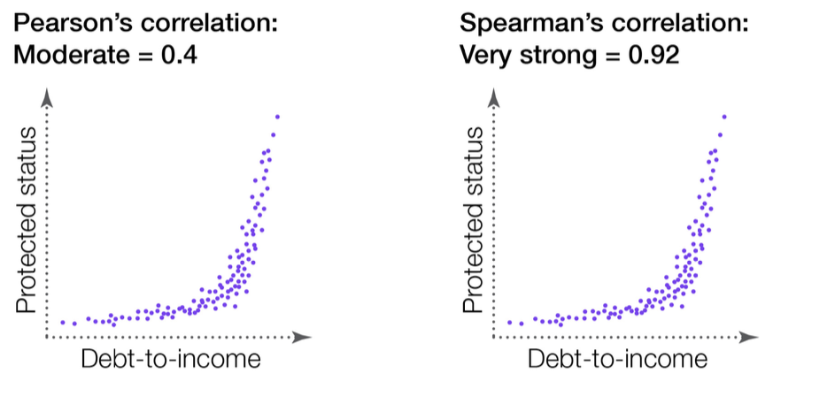
Spearman’s rho
For non-linear relationships

